Slide 1

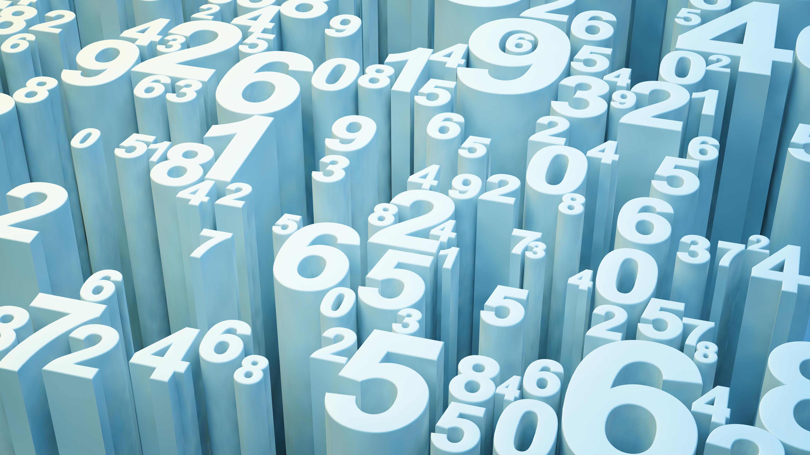
Predicting Heart Diseases
Alekhya Ponnekanti
Anika Mishra

Slide 2
Well, first is the story….
There once lived a man, a handsome, tall and not so young man.
His name is Leo.

Slide 3


Slide 4
Okay, this is a ML project.
Yeah, so Leo went for an annual check up and gets to know he may have some heart disease if he doesn’t take care of his health.
Hearing about this fans are devastated!! How can darling Leo have any issues??

Slide 5
Well, Leo’s issue is yet to be solved and we’ll soon finish it too.
But look what we stumbled upon:
An entire data set of heart diseases. And what's better, than to warn people about the future right??

Slide 6
So attending this IO class helped a lot.
It gave us all the knowledge we needed to work on this data set and classify: Basically design a flowchart like structure, which just simply says yes or no.
And so we used, DECISION TREES.

Slide 7
Algorithm Used: Decision Trees
Accuracy
The perfect method and the easiest algorithm for classification of data.
Data Analysis
Performed and analysed by keeping in mind: Entropy, Information Gain and Pruning.
Final Outcome
Good accepting range of accuracy, confirming the use of Decision Trees

Slide 8
Why decision trees? And not any of the jazz?
Flowchart like a tree structure to show the predictions that result from a series of feature-based splits.
Goal of machine learning is to decrease uncertainty or disorders from the dataset and for this, we use decision trees.

Slide 9
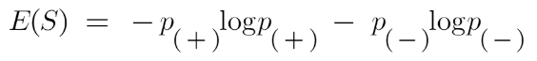
Features of a Decision Tree
ENTROPY: Nothing fancy, its nothing but the uncertainty in our dataset or measure of disorder.
It basically measures the impurity of a node. Impurity is the degree of randomness; it tells how random our data is. A pure sub-split means that either you should be getting “yes”, or you should be getting “no”.
Here p+ is the probability of positive class
p– is the probability of negative class
S is the subset of the training example
In order to make a decision tree, we need to calculate the impurity of each split, and when the purity is 100%, we make it as a leaf node.
Always remember that the higher the Entropy, the lower will be the purity and the higher will be the impurity.

Slide 10
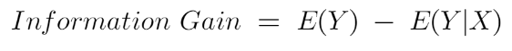
INFORMATION GAIN: How much the parent entropy has decreased after splitting it with some feature.
Information gain measures the reduction of uncertainty given some feature and it is also a deciding factor for which attribute should be selected as a decision node or root node.
Entropy of the full dataset – entropy of the dataset given some feature.
We will select the feature which has the highest information gain and then split the node based on that feature.

Slide 11
PRUNING
It is another method that can help us avoid overfitting.
It helps in improving the performance of the tree by cutting the nodes or sub-nodes which are not significant.
It removes the branches which have very low importance.

Slide 12
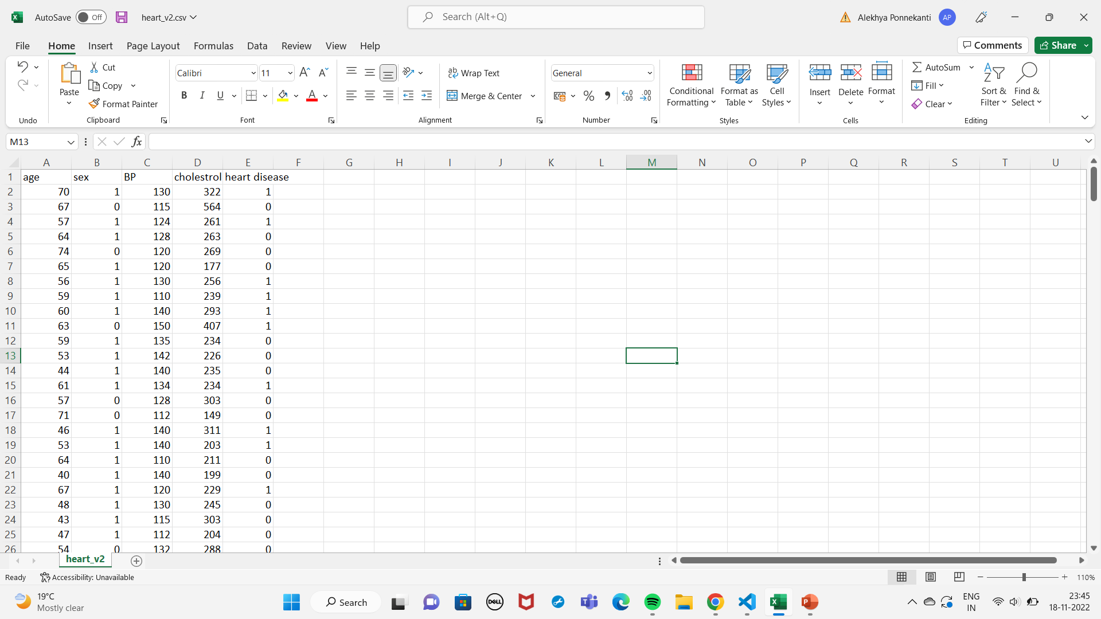
DATA SET

Slide 13
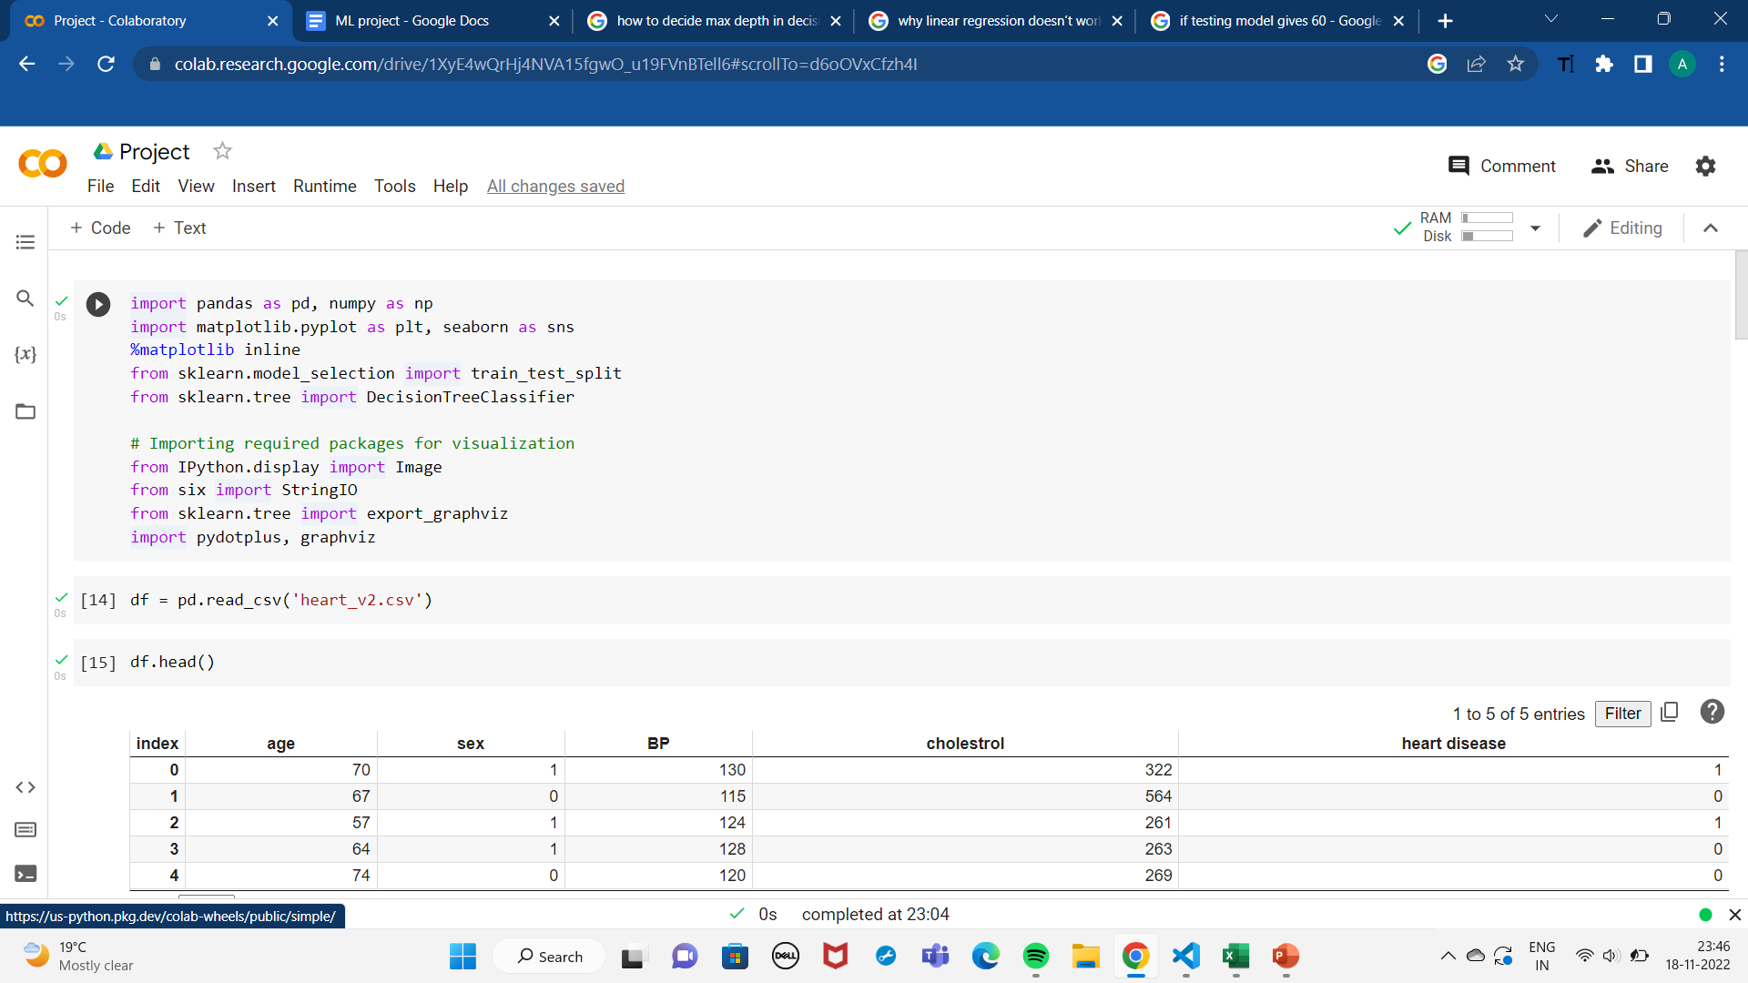

Slide 14
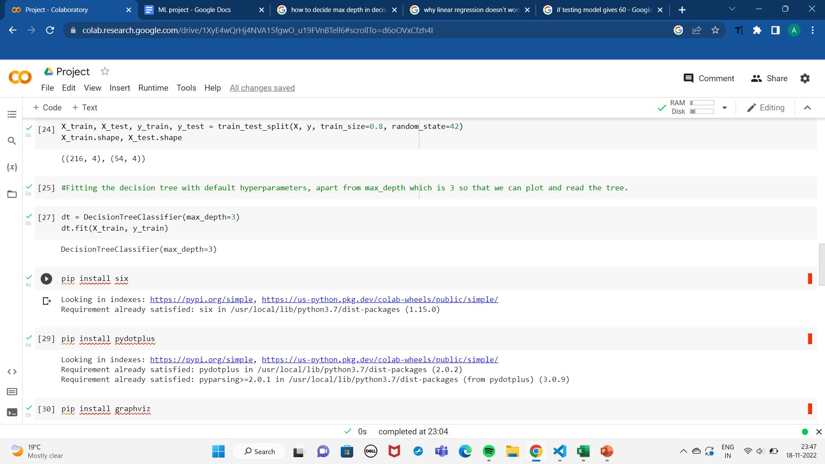

Slide 15
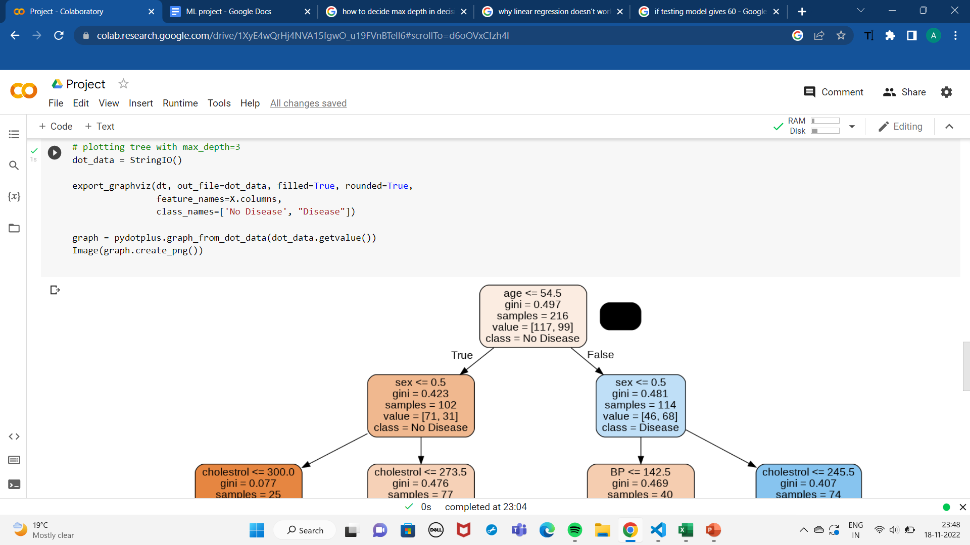

Slide 16
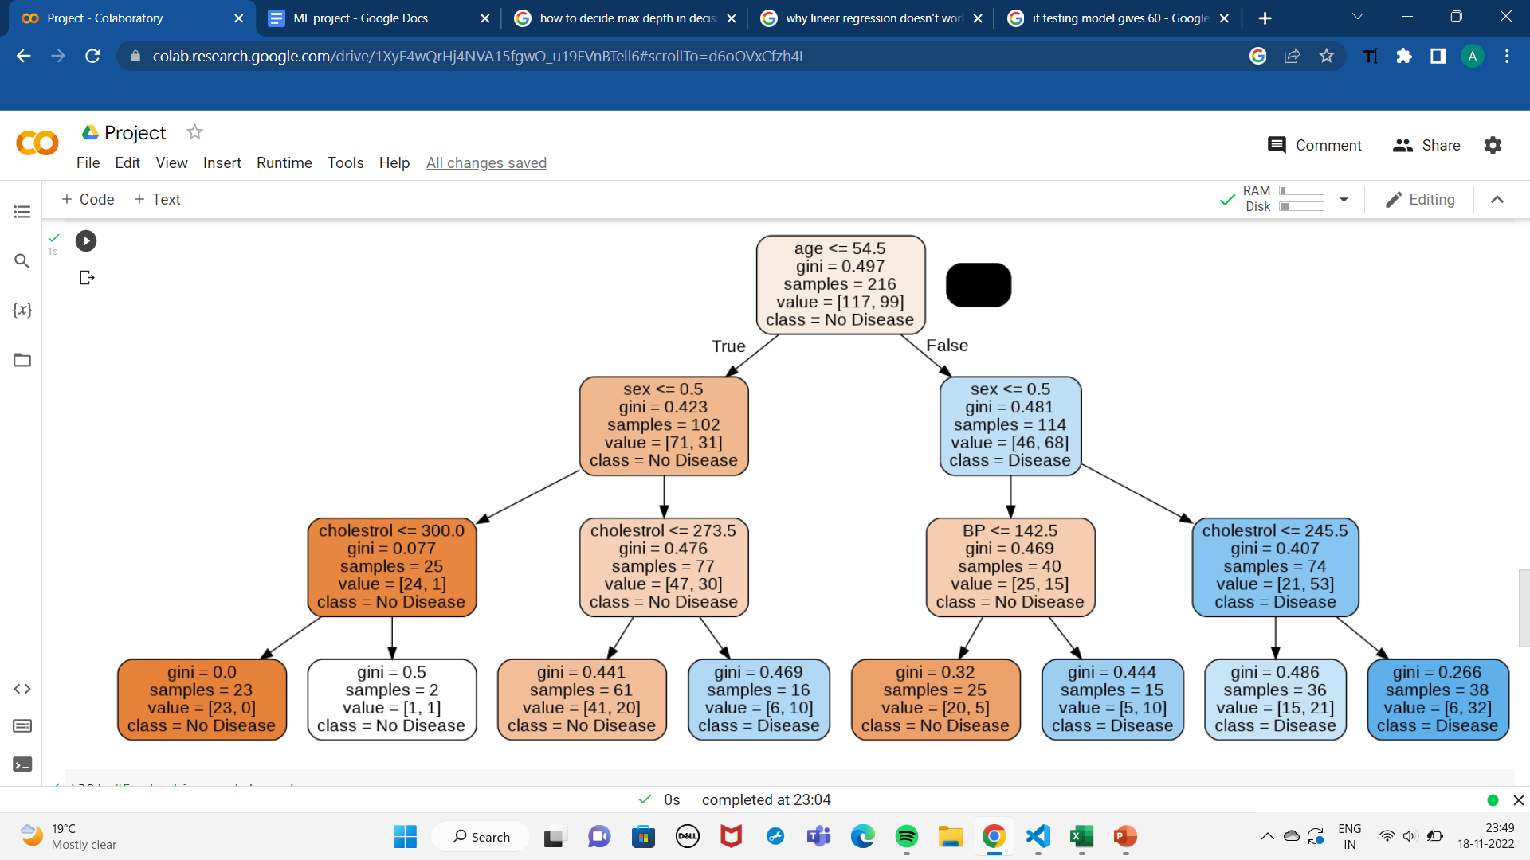

Slide 17
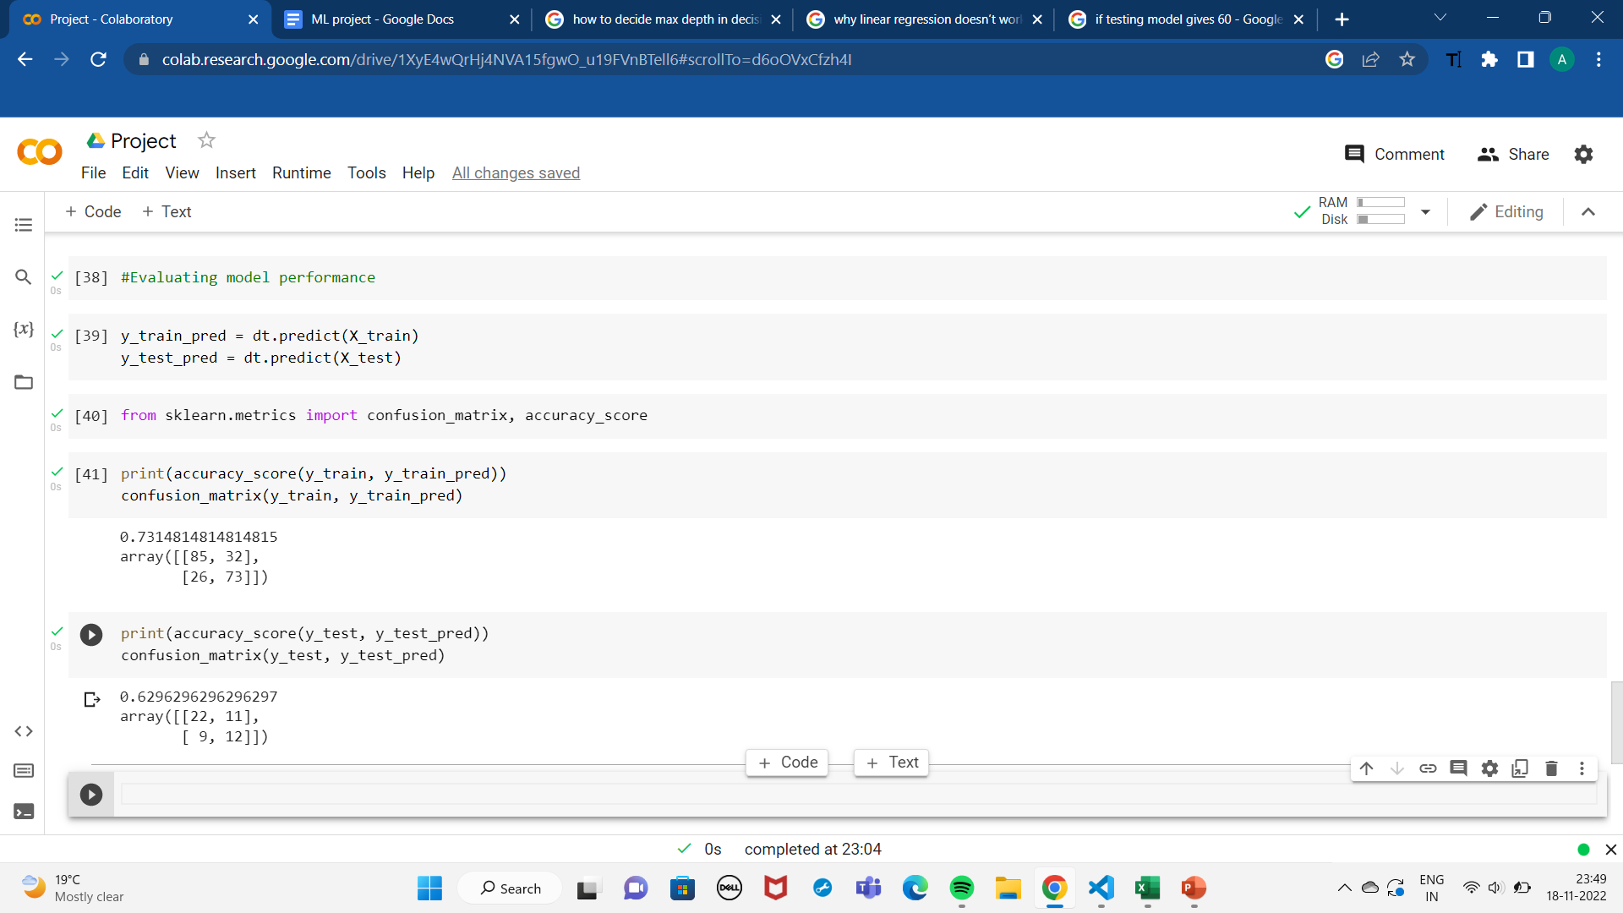

Slide 18
So yeah, that’s it with the prediction of heart diseases using decision trees.
Testing data set accuracy: 63%.
And IT’S A WRAP!!

